Slide 1
SMART SERVICE ASSISTANT
TEAM 48

Slide 2
TEAM 48
JOBIN LAGI THOMAS
SHAMIYA M R
ARYAMOL REJI
KRISHNANAND K
R ABHIRAMYA
Mentors:
ROHIT RAUT
PRAVEEN SOGALAD

Slide 3
CONTENT
PROBLEM STATEMENT
ADVANTAGES
INTRODUCTION
CONCLUSION
FUNCTIONS
TECH STACK
FUTURE SCOPE

Slide 4
PROBLEM STATEMENT
MAPPING
DIGITIZATION TO EASE ACCESS TO SOCIAL SERVICES
Smart Service Assistant: To simplify the use of online services provided by the government.
SHINAS SHAJI
SENSING
ENVIRONMENT
PATH PLANNING

Slide 5
INTRODUCTION
INTRODUCTION
Akshaya and e-Seva points consume too much time and money to provide various services.
Online services may be too complicated for the ordinary people to use.
MAPPING
SENSING
ENVIRONMENT
PATH PLANNING

Slide 6
INTRODUCTION
INTRODUCTION
MAPPING
Smart Service Assistant is a WhatsApp Chatbot, which automates the application processes of all government services.
The main idea of Smart Service Assistant is to simplify the process using popular and user friendly platforms like WhatsApp.
SENSING
ENVIRONMENT
PATH PLANNING

Slide 7

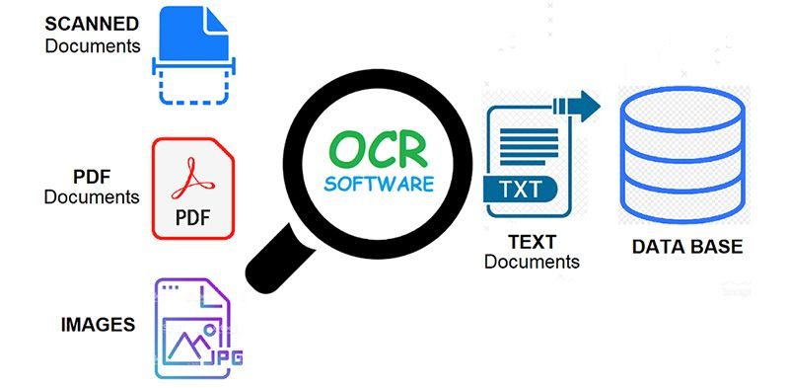



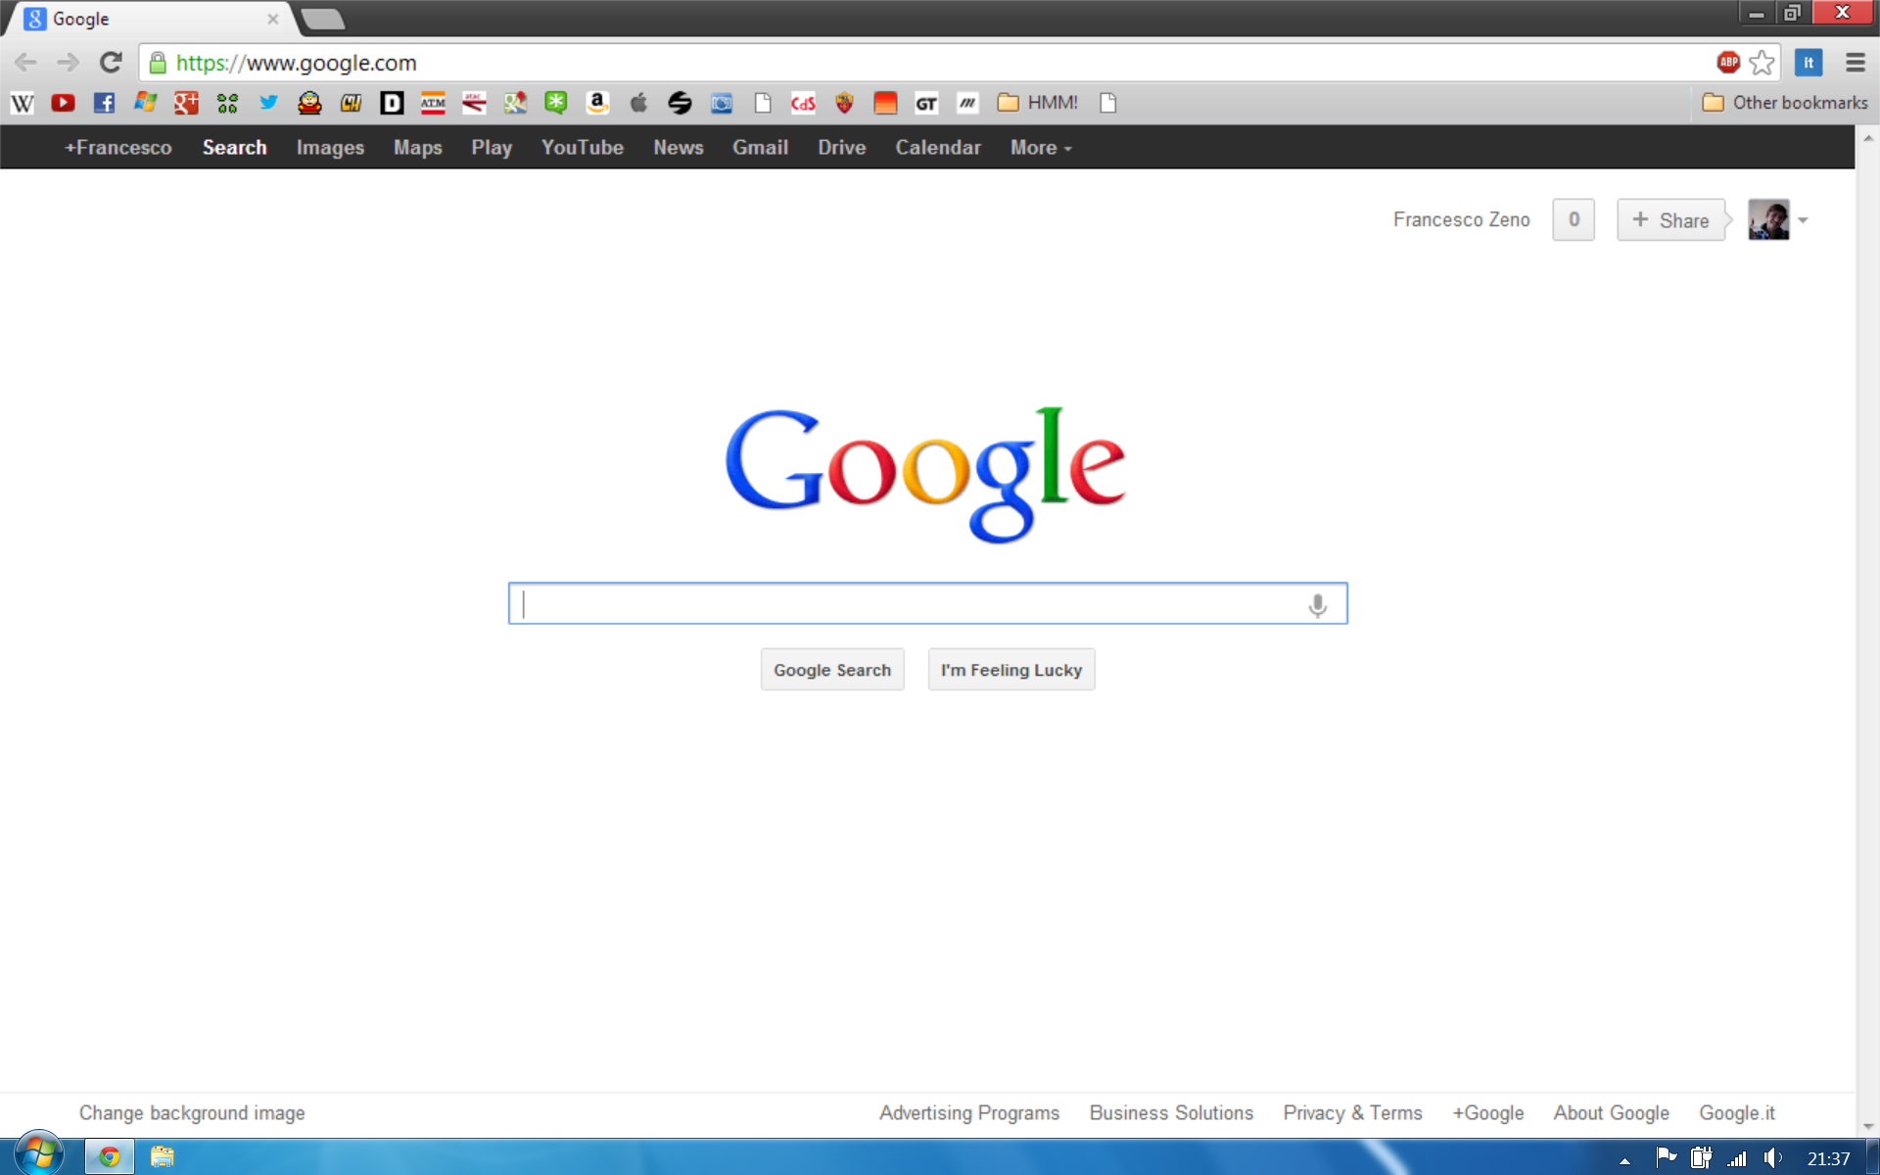
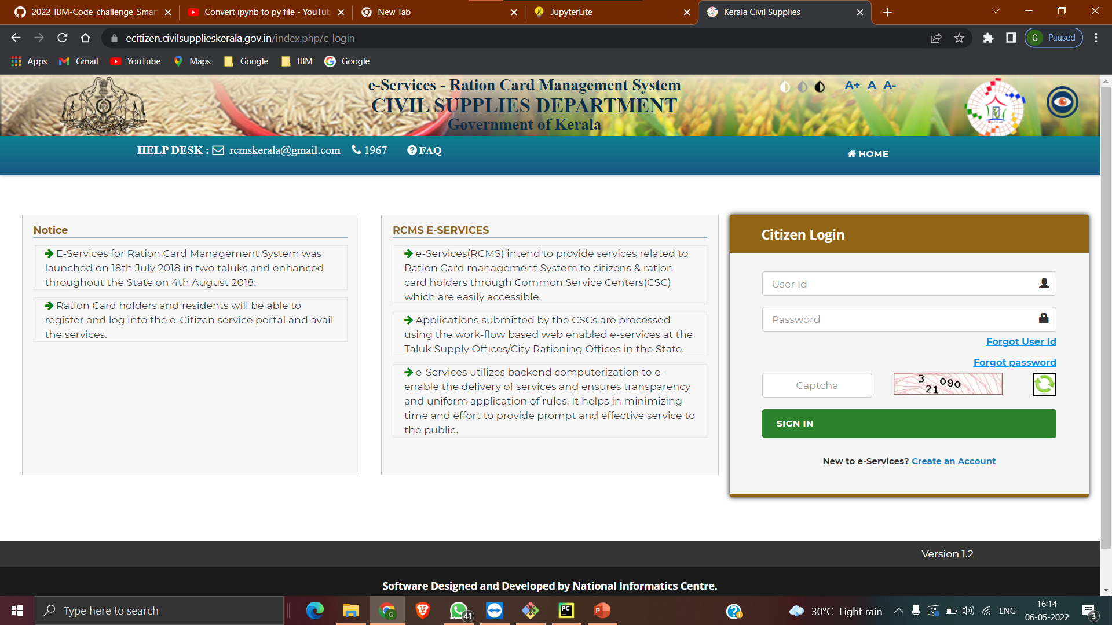

FLOWCHART
INTRODUCTION
MAPPING
getPantry Basket
Send Image to OCR Engine
Retrieve Extracted Information
SENSING
Sends details to the server
Python code
ENVIRONMENT
Request for details from server
Selenium web
driver
PATH PLANNING
Service automation
Web Browser
Smart Service Assistant Engine
Intelligent WhatsApp chatbot

Slide 8
FUNCTIONS OF
THE BOT
MAPPING
DELIVER CONTEXTUAL RESPONSES
SENSING
AUTO POPULATION OF FORMS AND APPLICATIONS
ENVIRONMENT
AUTO EXTRACTION OF DATA FROM DOC IMAGES
PATH PLANNING
PROVISION OF MULTIPLE SERVICES

Slide 9
TECH STACK
CURRENT
PROGRESS
Selenium Web Driver
​
Python​
​WhatsApp Beta
Optical Character Recognition

Slide 10
ADVANTAGES
User friendly
Save Time and Money
Reduce Stress and People-to-People interactions

Slide 11
FUTURE SCOPE
SOFTWARE & COMPONENTS
Aadhar Updation
National Voters Service Portal
Almost all Government Online Service

Slide 12
CONCLUSION
SOFTWARE & COMPONENTS
All these services are rapidly available and by using an automation server any authorized user can make use of these services from their doors even without a computer or without adequate technical knowledge.

Slide 13
"Hey! now you have your SMART SERVICE ASSISTANT with you..."
THANK YOU​

